Slide 1
Creative Arts – Visual Art
Year 8

Slide 2
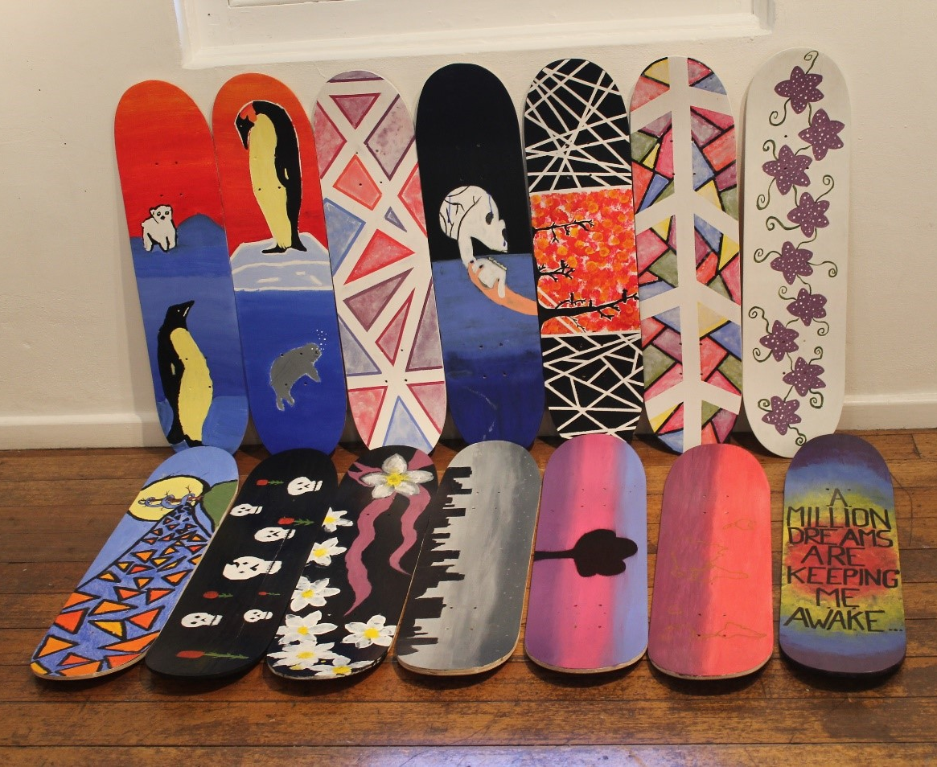
What do you do?
Make Drawings, Paintings, Prints and Sculptures
Appreciate Art made by people from different cultures and historical periods.
Experiment with Art materials.
Try new techniques and refine some old ones.
Generate your own original ideas and images.
Exhibit your work.

Slide 3
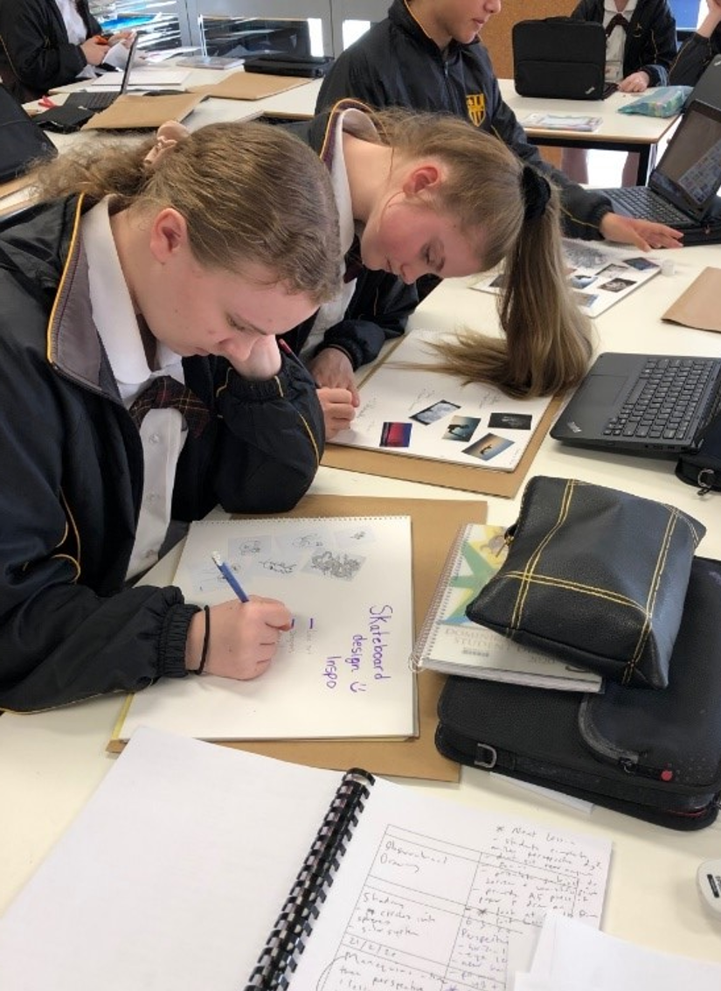
What you need?
The ability to work independently.
A willingness to try new things.
A desire to make things.

Slide 4
Find out more…
Please feel free to contact Mr Mike O’Brien, Head of Creative Arts, at mobrien@dominic.tas.edu.au

